Slide 1


Drone Battery Management System
Review-I
AY 2025-26
Capstone Project – Introduction (PROJ2999)
GITAM (Deemed-to-be) University
Department of Electrical Electronics and Communication Engineering
Project Team:
Sharath BU22EECE0100472
CH Sumanth BU22EECE0100473
Kamalesh V G BU22EECE0100481
Project Mentor:
Pradyumna Ranjan Ghosh
Project In-charge:
Dr. Subhashish Tiwari/ Dr. Ambar Bajpai
www.gitam.edu

Slide 2
Objective and Goals
Objective
To design and evaluate a split battery system to mitigate the effects of voltage drop in drones, thereby enhancing stability and preventing crashes.
Goals
Main Goals
Additional Goals
Develop a low-voltage detection circuit to monitor battery status.
Design an electronic switching mechanism for seamless power transfer between batteries.
Integrate a dual-battery system onto a drone platform.
Test and validate the system's performance under high-load conditions and during demanding maneuvers.
Optimize the system for minimal weight and size.
Analyze the impact of the system on overall flight endurance.
Compare the performance of the split battery system with a single-battery system

Slide 3
Literature Survey
Key Publications
Design and Simulation of Battery Thermal Management System for Electric Vehicles , Vanya Goel , Snigdha Chaturvedi
The Drone Scheduling Problem: A Systematic State-of-the-Art Review, Junayed Pasha ,ZeinabElmi Yui-Yip Lau , Sumit Purkayastha , Amir M. Fathollahi-Fard, Ying-En Ge, , and Maxim A. Dulebenets , Senior Member, IEEE
Key Resources – Whitepaper| Application Notes | Datasheet| Others
Low-Voltage Detection Circuits: Comparators, such as Texas Instruments' TLV7081, are commonly used for under-voltage detection in battery-powered devices. These circuits can be designed to be nano-powered for low-power consumption.
Electronic Switches: Electronic PWM switches and e-power switches are available for remote control and drone applications to control power to onboard devices. These can be controlled via a signal from the flight controller or detection circuit.
Battery Management Systems (BMS): A BMS is essential for monitoring individual battery cells and detecting imbalances. It can be integrated with isolation techniques like diodes or relays to protect against over-discharge if one battery's voltage is lower than the others.
Existing Implementations – Products| Opensource| GitHub etc
DIY Circuits: Hobbyists and engineers can build custom low-voltage monitoring circuits using voltage dividers and comparators to send a signal to the flight controller.
Commercial Drones: Some commercial drones and UAVs already utilize multi-battery systems, often connecting them in parallel, to increase energy capacity and provide redundancy for longer flights and heavier payloads. Companies like Tattu and Grepow offer smart batteries with integrated BMS to manage these systems.
Flight Controller Integration: Many modern flight controllers have built-in battery monitoring ports for voltage and current, allowing for the configuration of failsafe actions (e.g., auto-land) when voltage drops below a certain threshold.

Slide 4
Project Plan (Clearly mention milestone for objectives under each reviews)
Task / Phase | M1 | M2 | M3 | M4 | M5 | M6 | M7 | M8 | M9 | M10
1. Project Planning & Research
1.1 Project Title & Objective Finalization | ⚫
1.2 Literature Review & Market Survey | ⚫ | ⚫
1.3 System Requirements & Specifications |  | ⚫ | ⚫
1.4 Component Selection (IC, MCU, etc.) |  |  | ⚫
1.5 Finalize Project Plan & Report Synopsis |  |  | ⚫
2. Hardware Design & Prototyping
2.1 Schematic Design & PCB Layout |  |  |  | ⚫
2.2 Component Procurement |  |  |  | ⚫
2.3 PCB Fabrication & Soldering |  |  |  |  | ⚫
2.4 Power Circuitry & Sensing Module Design |  |  |  |  | ⚫ | ⚫
3. Software & Algorithm Development
3.1 Microcontroller Firmware Development |  |  |  |  | ⚫ | ⚫
3.2 State of Charge (SOC) Algorithm |  |  |  |  |  | ⚫ | ⚫
3.3 State of Health (SOH) Estimation |  |  |  |  |  |  | ⚫ | ⚫
3.4 Cell Balancing Logic (Passive/Active) |  |  |  |  |  |  | ⚫ | ⚫
4. Integration & Testing
4.1 Integration of Hardware & Software |  |  |  |  |  |  |  | ⚫
4.2 Unit Testing of Modules |  |  |  |  |  |  |  | ⚫ | ⚫
4.3 Full System Testing & Debugging |  |  |  |  |  |  |  |  | ⚫ | ⚫
4.4 Performance Evaluation with Drone |  |  |  |  |  |  |  |  |  | ⚫
5. Documentation & Presentation
5.1 Project Report Writing |  |  |  |  |  |  |  |  | ⚫ | ⚫
5.2 Final Report Submission & Viva Prep |  |  |  |  |  |  |  |  |  | ⚫

Slide 5
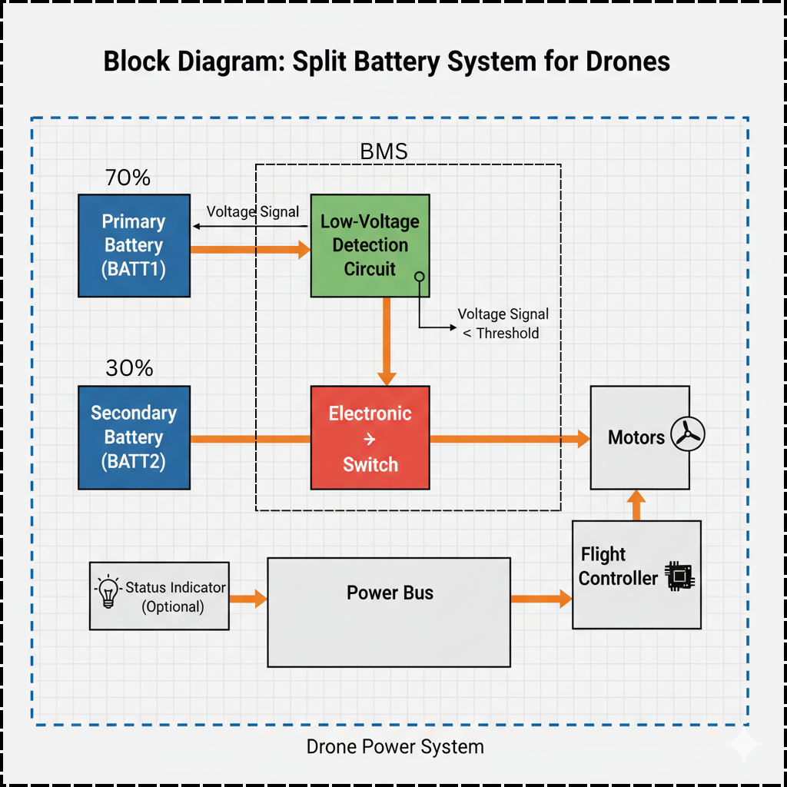
Architecture
Block Diagram

Slide 6
Use Cases & Testing
Use Cases
High-Current Maneuver: The drone performs a sudden, aggressive maneuver (e.g., a rapid climb). The primary battery's voltage sags, triggering the switch to the secondary battery, maintaining motor power and stability.
End-of-Flight Transition: The primary battery naturally depletes over time. As its voltage drops below the threshold, the system switches to the secondary battery, allowing for a controlled descent or return-to-home without risking a crash
Heavy Payload: The drone carries a heavy load, causing continuous high current draw. The system automatically switches to the secondary battery to prevent premature depletion of the primary, extending the flight.
Test Cases
Measure the switching time from primary to secondary battery to ensure it is instantaneous and does not disrupt flight.
Verify that the low-voltage detection circuit triggers accurately at the specified threshold.
Record flight stability (e.g., in terms of altitude and orientation) during and after the battery switch.

Slide 7
Implementation and Results – Iteration 1
Iteration 1: Preliminary Results
Component Prototyping: Developed and tested the low-voltage detection circuit and electronic switch on a breadboard.
Simulation: Used software like MATLAB/SIMULINK with SIMSCAPE, as mentioned in the literature, to simulate the effect of voltage drop and a switching event on a drone's power system.
Findings: Initial simulations show that a sudden voltage drop can be successfully detected, and the switch can be activated to maintain a stable output voltage. The challenge lies in minimizing the switching time and preventing any momentary power interruption.
Next Steps: Move from simulation to a physical prototype to test with actual batteries and motor loads.

Slide 8
PART :- 1 RESULT

Slide 9
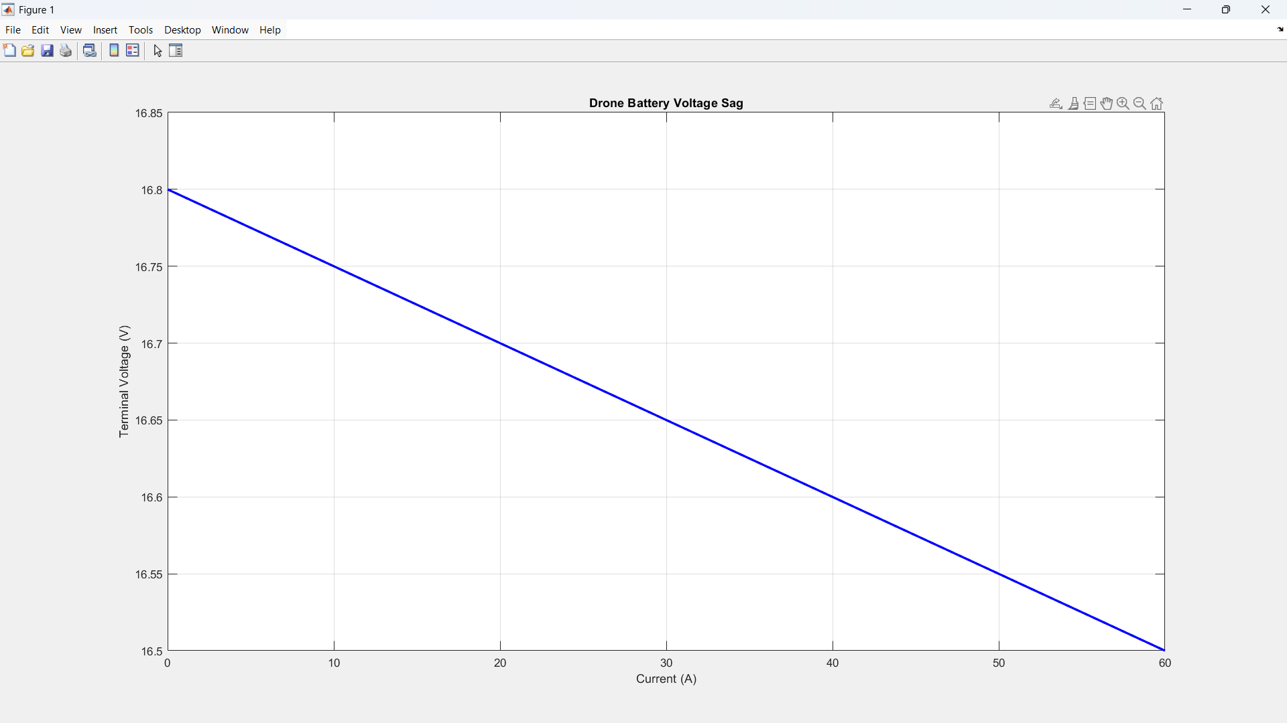
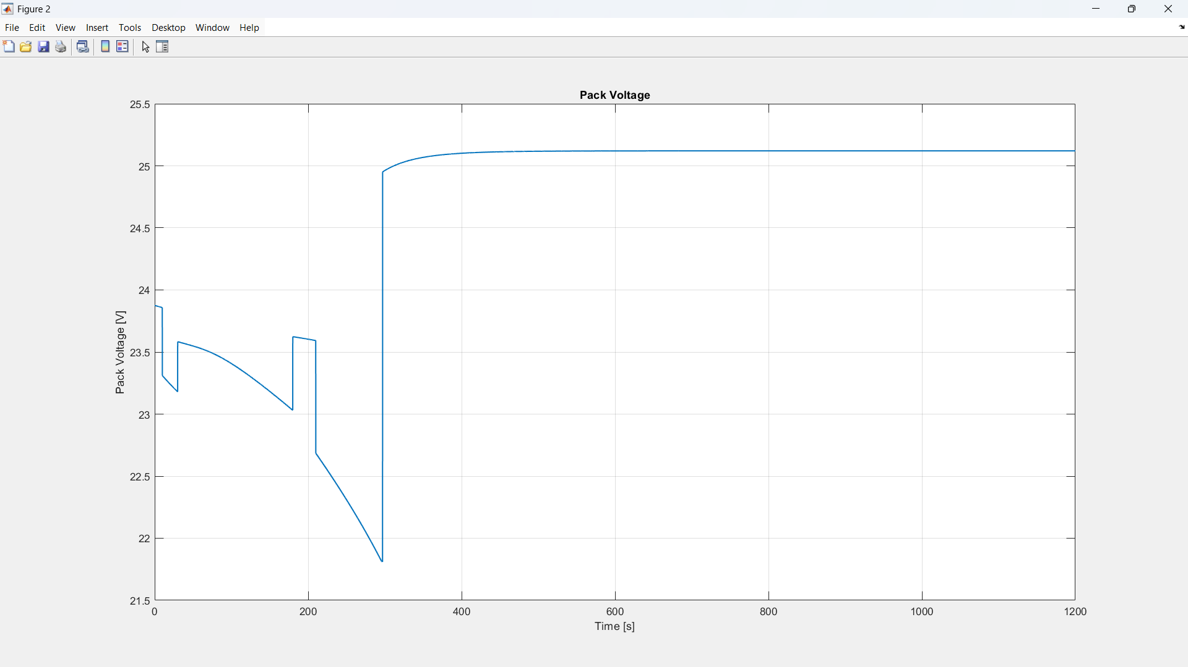
Graph 1:-
Graph 2:-

Slide 10
Discussion
Graph 1:-
  Initial Voltage: At 0 Amps (no load), the voltage is at its highest, around 16.8V. This is the open-circuit voltage of the battery.
  Voltage Drop: As the current increases from 0 A to 60 A, the terminal voltage drops steadily from 16.8V to about 16.5V. This 0.3V difference is the voltage sag.
  Performance Indicator: This graph is a good way to determine the health of a battery. A healthy, low-resistance battery will have a flatter slope and less voltage sag, while an older or damaged battery will have a steeper slope and a more significant voltage drop under the same load.
Graph 2:-
  Discharge Phase (0 to ~275 seconds): The voltage fluctuates and generally trends downwards. The sharp downward spikes (e.g., around 100s and 250s) are likely caused by high current draws from the drone's motors, similar to the voltage sag seen in the first graph. This could simulate the drone taking off or performing an aggressive maneuver. The voltage then recovers slightly when the load is reduced
  Full Charge (400+ seconds): The voltage remains stable at approximately 25.2V, indicating that the battery is fully charged and the charging process has completed.

Slide 11
PART :- 2 RESULT

Slide 12
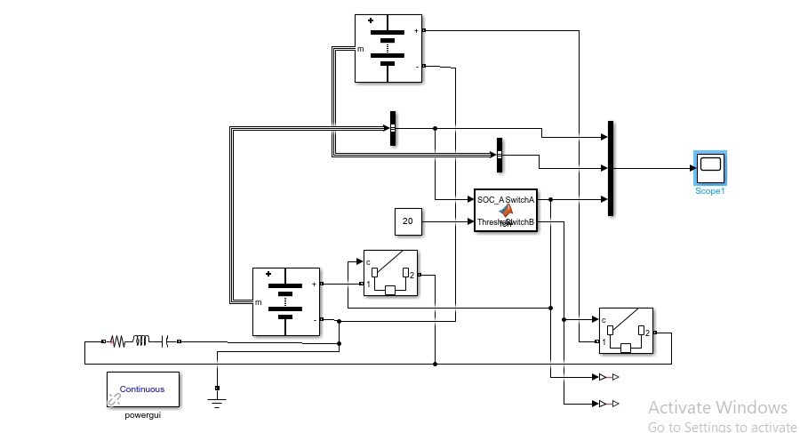
Working Module
Primary Battery
mux
Breaker 1
Breaker
Matlab function
Secondary Battery
Breaker 2
RLC

Slide 13
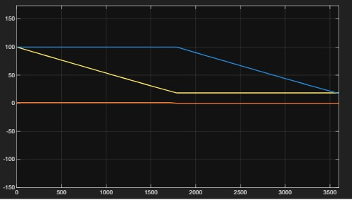
secondary
Battery percentage
Primary
Time(s) stop time 2000s

Slide 14
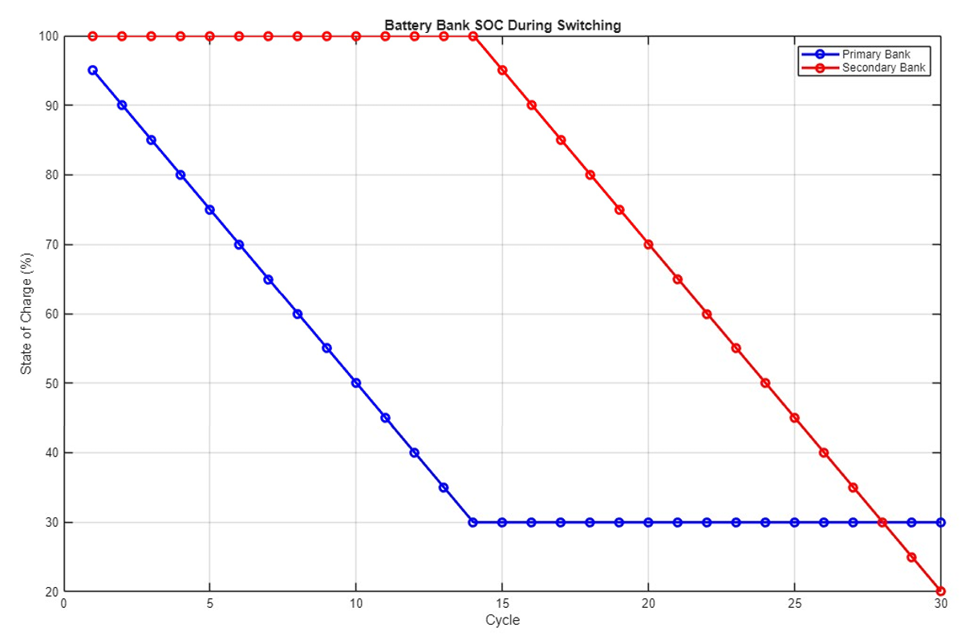

Slide 15
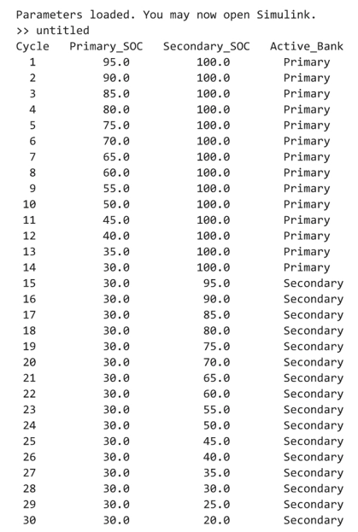
Code result

Slide 16
Conclusion & Future Work
Summary and Conclusion
Our research demonstrates that a split battery system is a viable and effective method to counter the challenges of voltage drop in drones. The system successfully monitors battery health and seamlessly switches power sources when needed, preventing instability and potential crashes. This approach not only enhances the drone's safety and reliability but also extends its operational endurance. The system's design is a significant step towards creating more robust and dependable drones for a wide array of applications.
Future Work
Integrate the system with a BMS to provide more advanced battery health monitoring and predictive analytics.
Explore incorporating a hybrid power source (e.g., solar cells) into the system for continuous charging of the secondary battery
.
Develop intelligent algorithms to predict voltage drop based on flight telemetry (e.g., motor current, throttle input) and initiate the battery switch proactively, before the voltage threshold is reached

Slide 17
THANK YOU
Have a Great Day !

